Slide 1

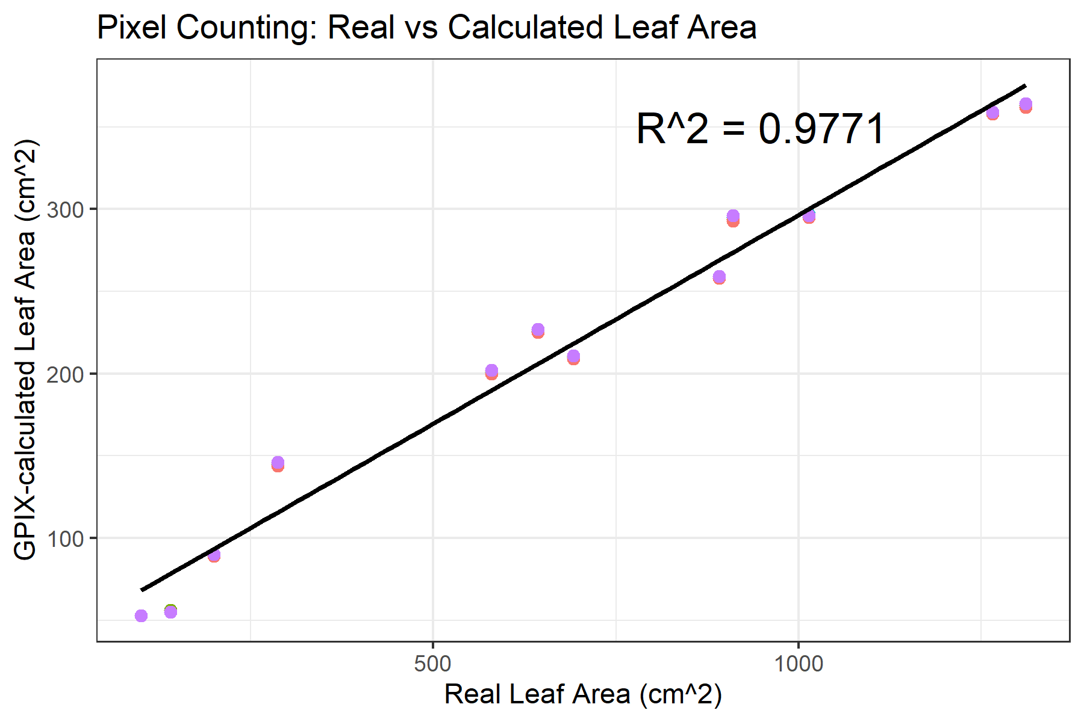
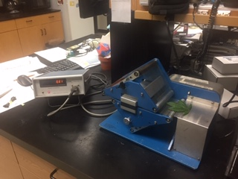
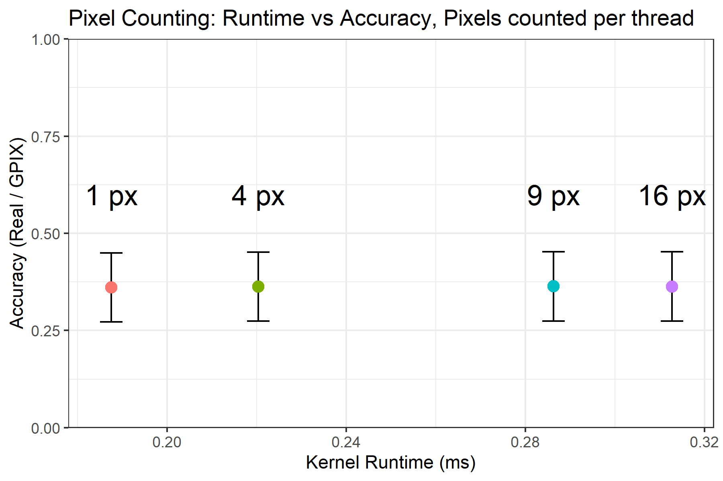
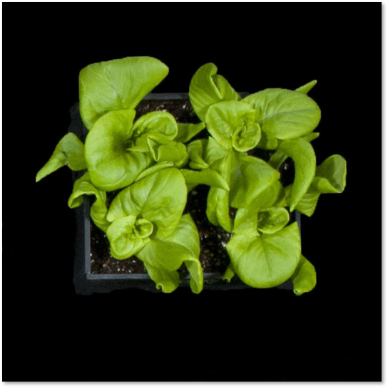
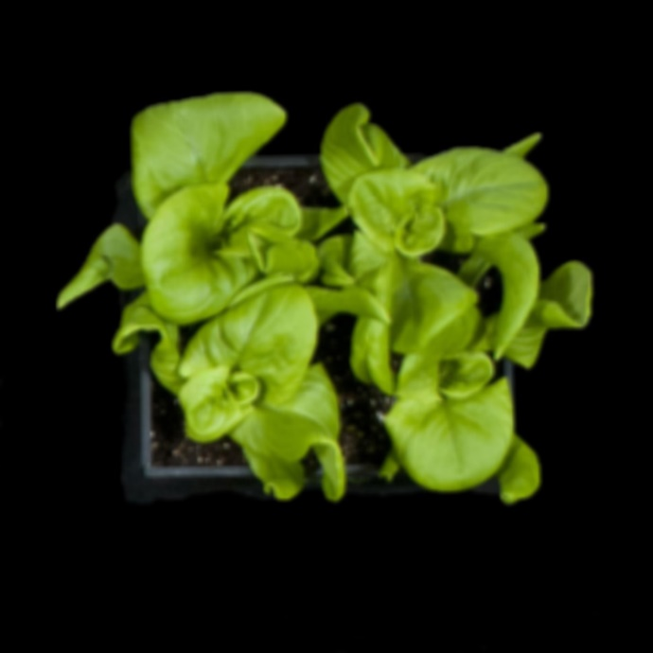
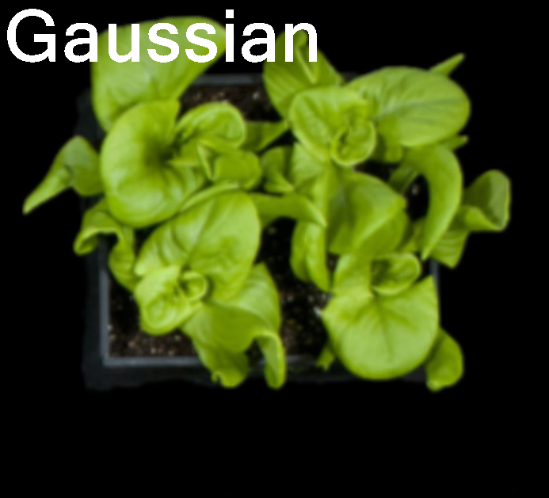
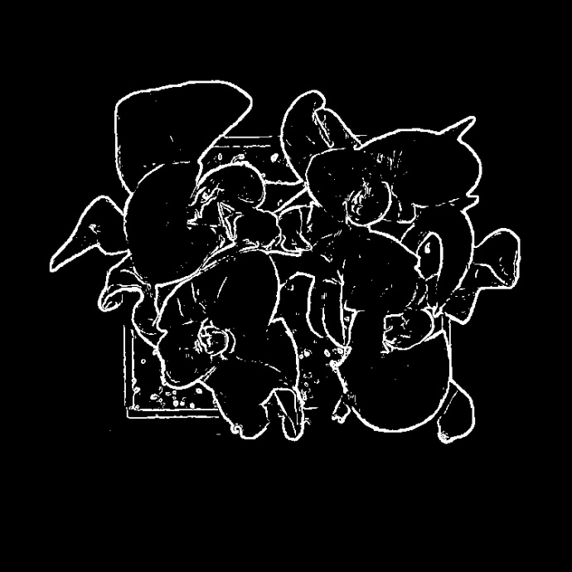

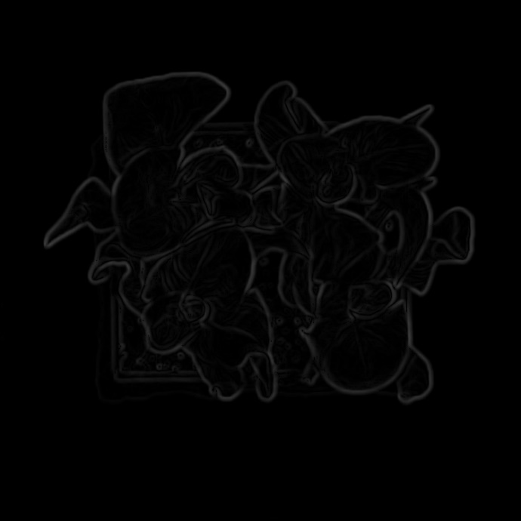
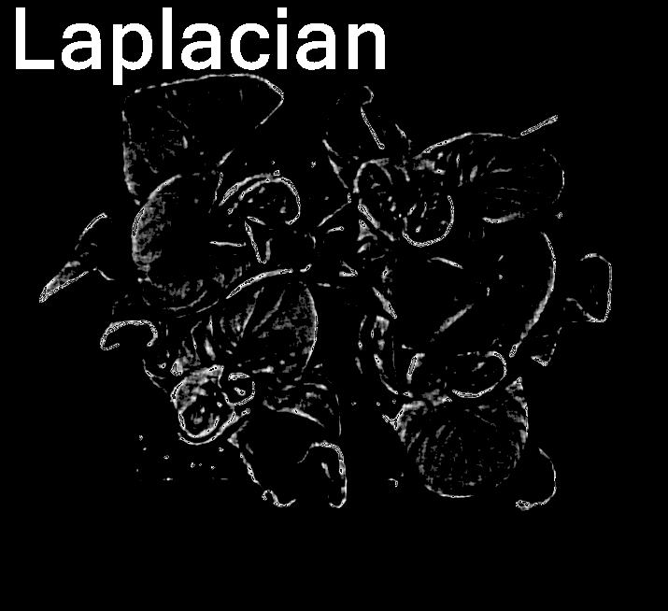

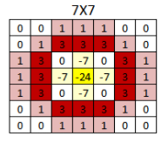
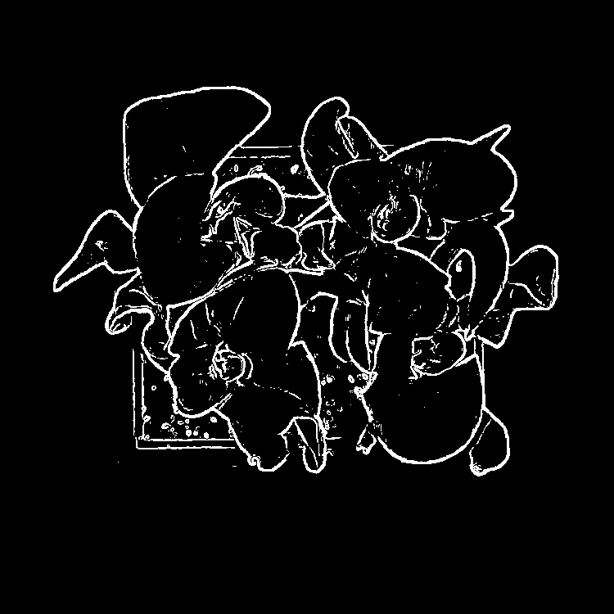
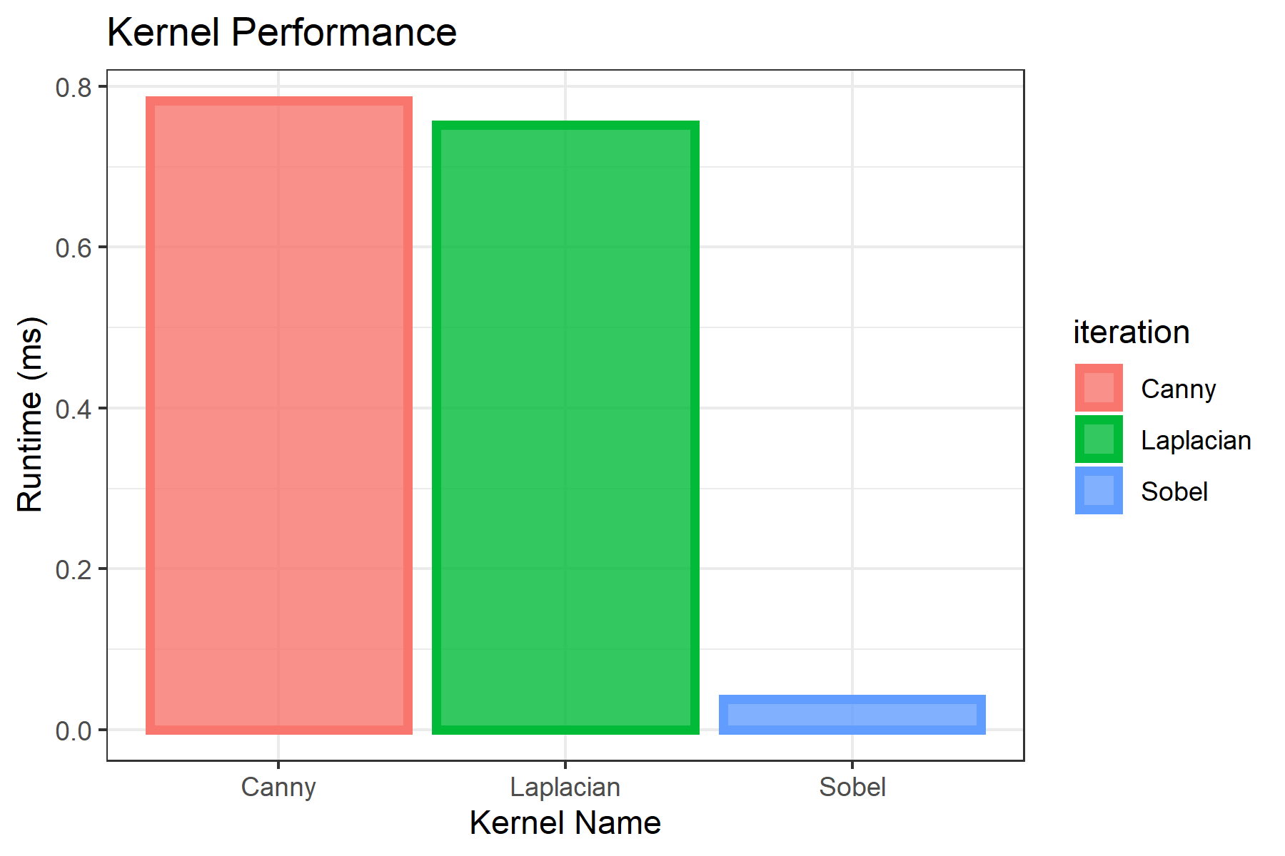
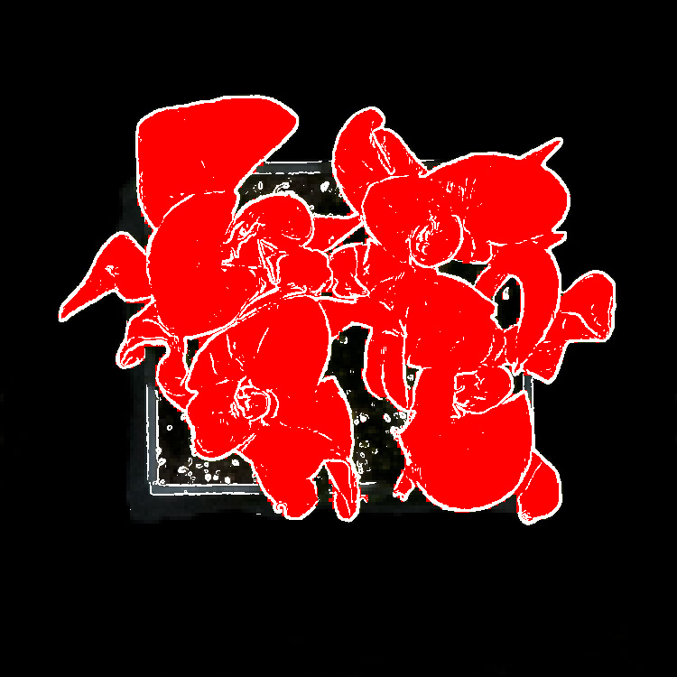
GPIX: Plant Cover Calculation Accelerated With GPUs
Jakob Johnson, Bruce Englert, Bashar Al-Habash
Background and Motivation
Results
Our goal is to create a tool to allow farmers to analyze how well plants are growing without harvesting the plants to weigh them or calculate their leaf area.
25% of leaf area visible and detected
Number of green pixels and plant surface are very highly correlated
Can serve same purpose as leaf area measurements
We want to reduce that to simply snapping a photo, and allow real-time analysis of crops’ growth performance in the field
Larger average area did not decrease accuracy but did increase runtime.
Algorithm is compute-bound.
Previous Work
Canny
Laplacian
Sobel
Other algorithms have been used on GPUs to calculate plant leaf area,
Thresholding algorithms
Triangle mesh methods
Otsu thresholding
Gaussian
Filter
Method
Suppression
Sobel is a much simpler algorithm, which is why it’s runtime is significantly faster than the multi-stage algorithms
Original Image
Hysteresis
Filter
Edge Detection (Sobel, Canny, or Laplacian)
But the multi-stage algorithms do a better job at isolating the plant
Acknowledgements
Plant Pixel Count
(1) Ozdemir and T. Altilar, "GPU based parallel image processing for plant growth analysis," 2014 The Third International Conference on Agro-Geoinformatics, Beijing, China, 2014, pp. 1-6, doi: 10.1109/Agro-Geoinformatics.2014.6910629.
(2) Huai Yongjian, Li Jingli, Wang Lichen, and Yang Gang. "Plant Leaf Modeling and Rendering Based-On GPU." 2009 First International Conference on Information Science and Engineering (2009): 1372-375. Web.
(3) Winberg, Simon, Naidoo, Khagendra, & Ramone, Moeko. (2017). “Accelerating computer-based recognition of fynbos leaves using a Graphics Processing Unit.” South African Computer Journal, 29(3), 238-262. https://dx.doi.org/10.18489/sacj.v29i3.432
Also thanks to Paul Kusuma from the USU Crop Physiology Laboratory

